Slide 1
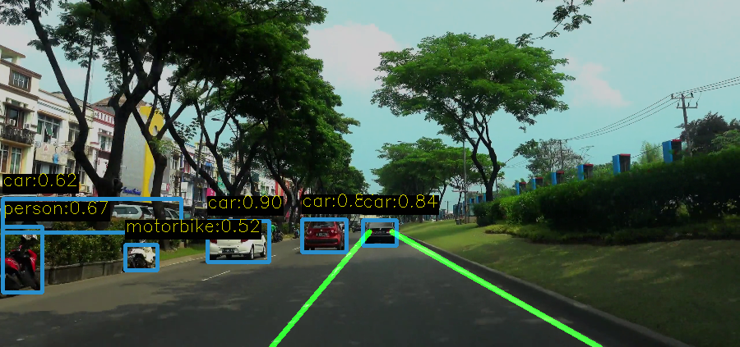
Autonomous Lane and Number plate detection using Classic Computer Vision and Deep Learning
CS 5330: Pattern Recognition and Computer Vision
Members: Dev Vaibhav | Siddharth Maheshwari | Skanda Akkihebbal Prasanna

Slide 2
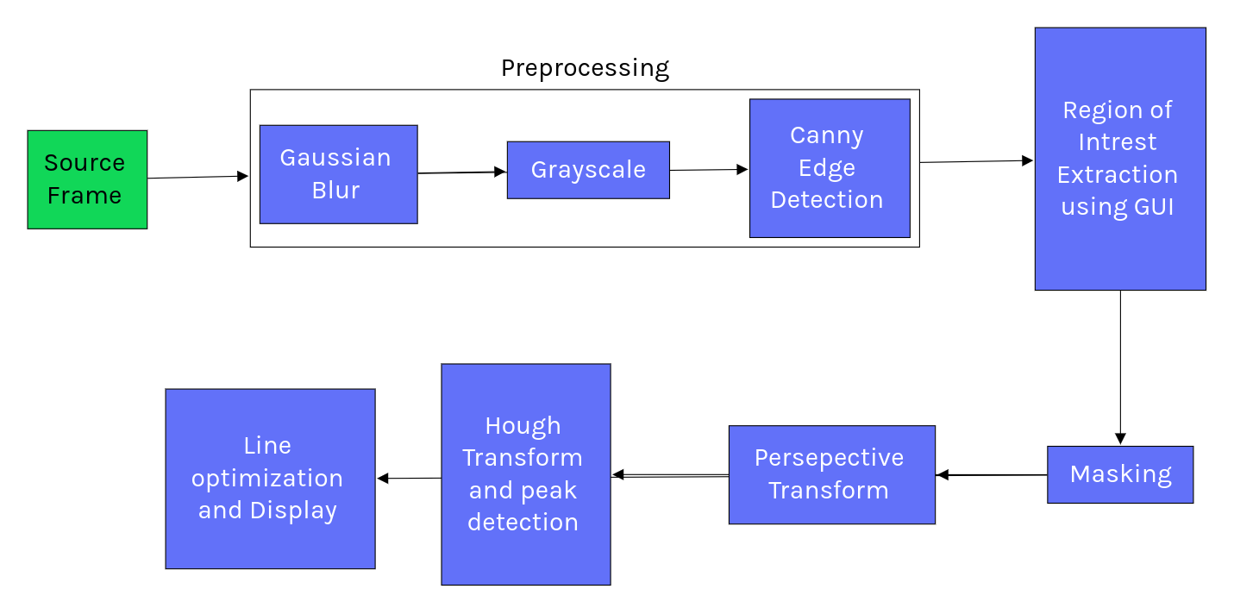
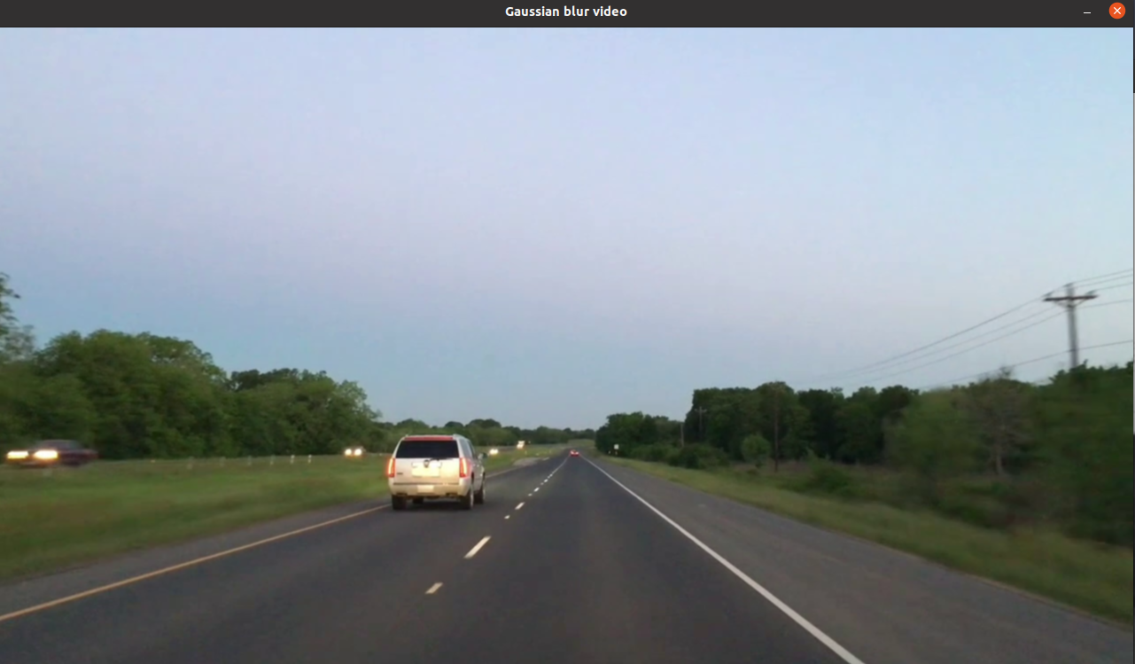
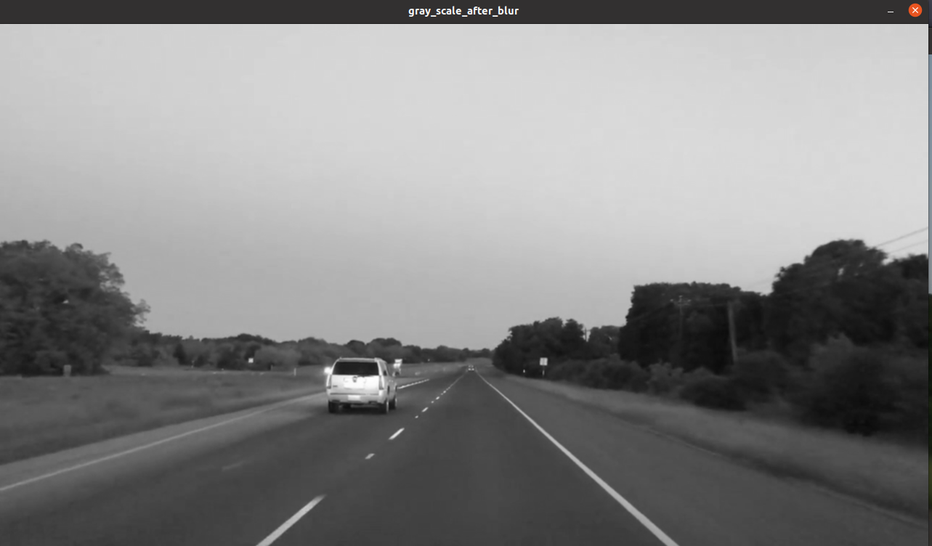
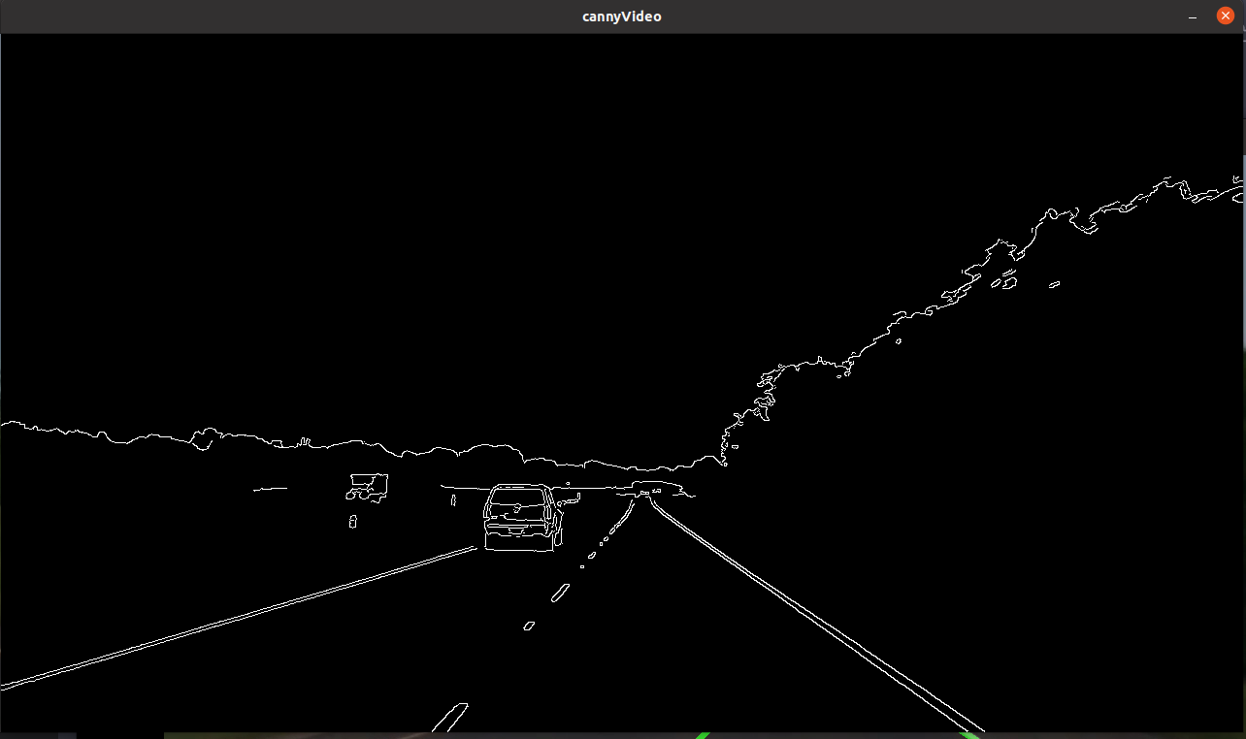
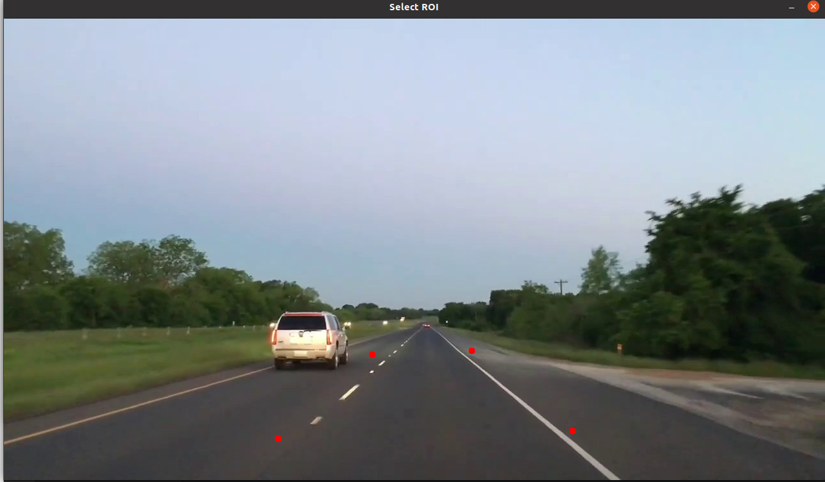
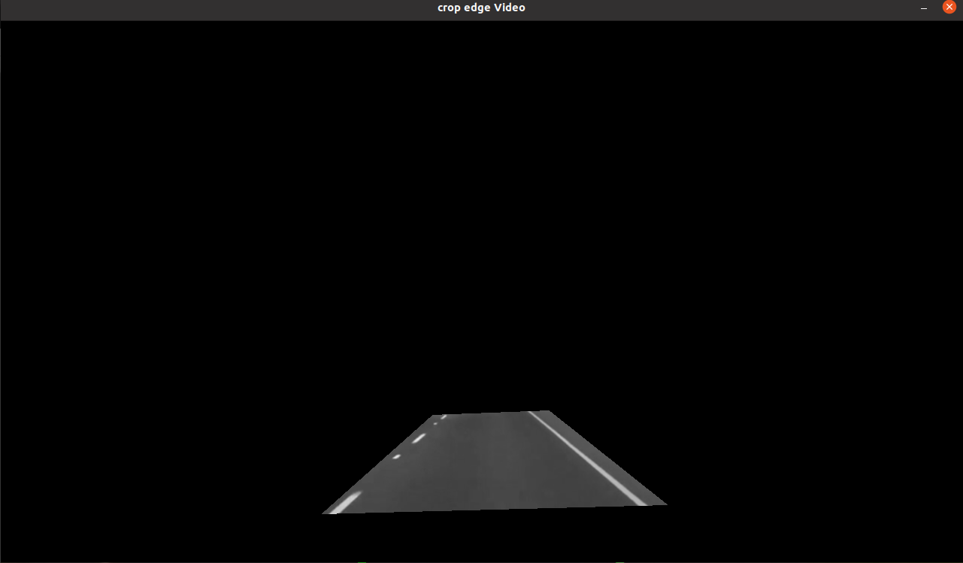
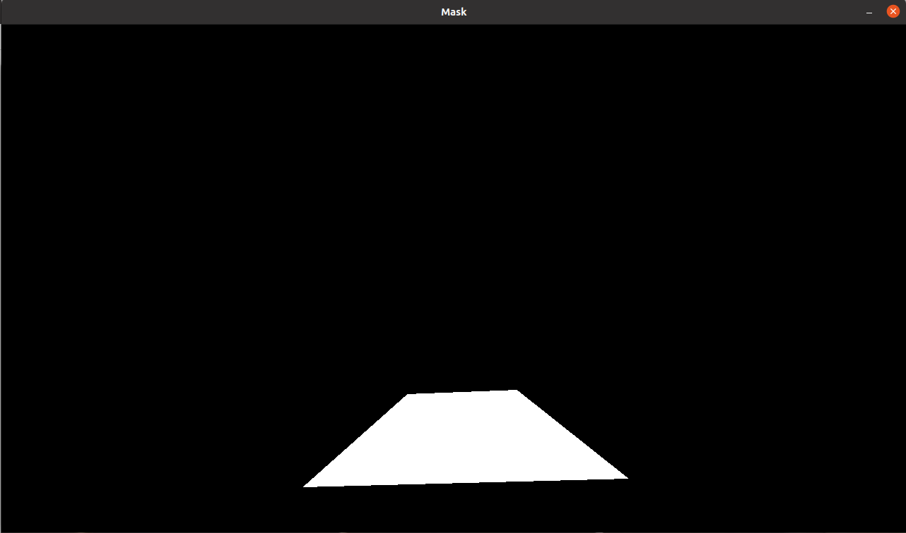
Lane Detection Using Classical Computer Vision Approach
Gaussian Blur, Grayscale, Canny Edge Detection, ROI Extraction, Cropped Edges, Mask Output (Left to Right)

Slide 3
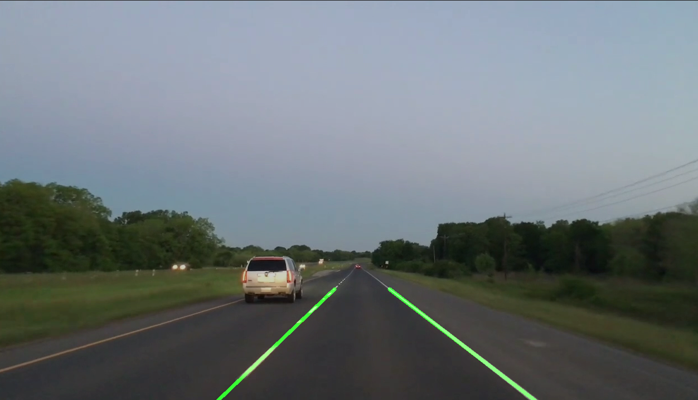
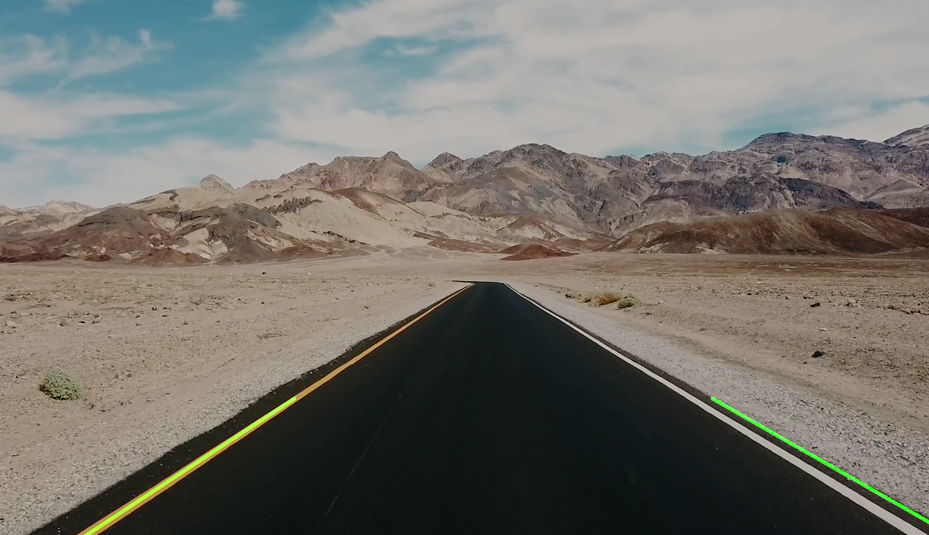
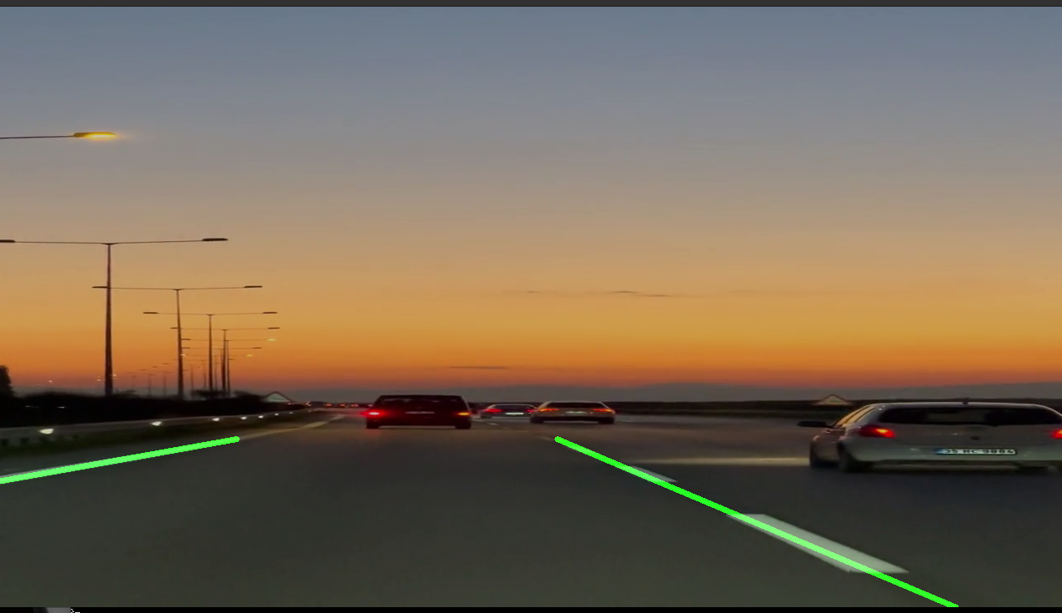
Lane Detection Using Classical Computer Vision Approach
Lane Detection in not-so-bright sunlight, on a sunny day, and, during dusk(Left to Right)

Slide 4
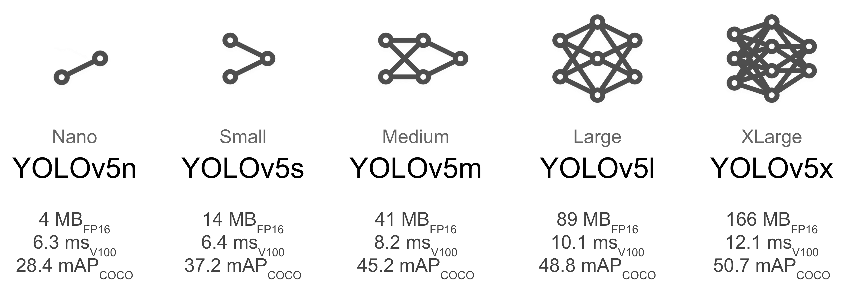
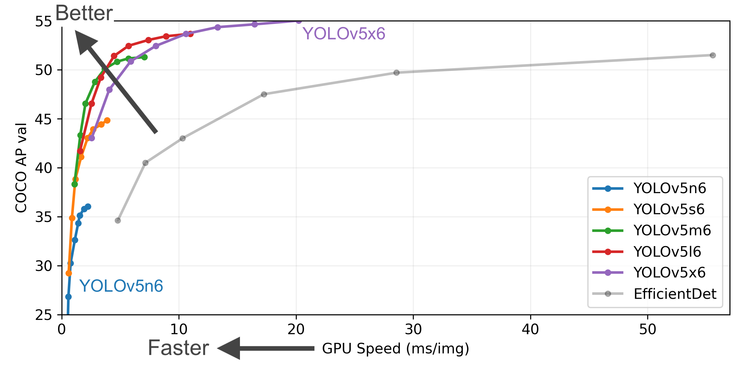
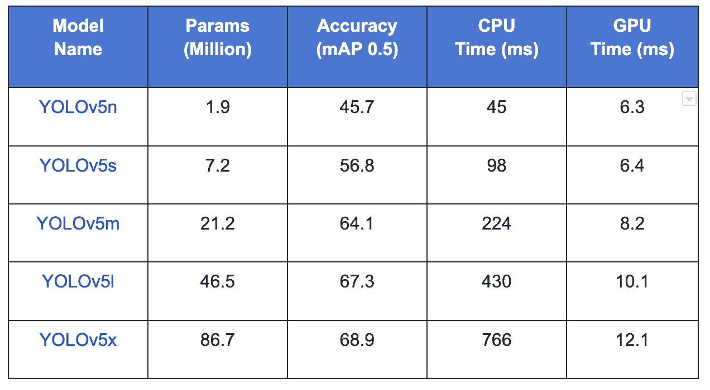
Object Detection using YOLOv5

Slide 5
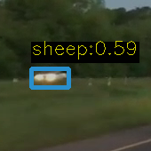
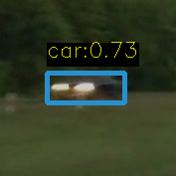
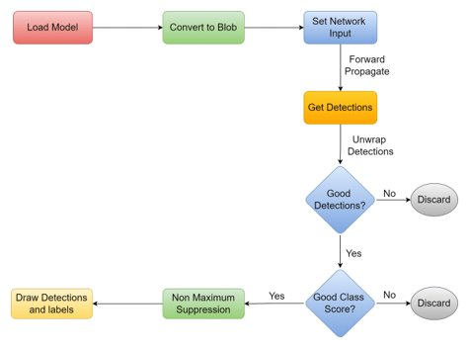
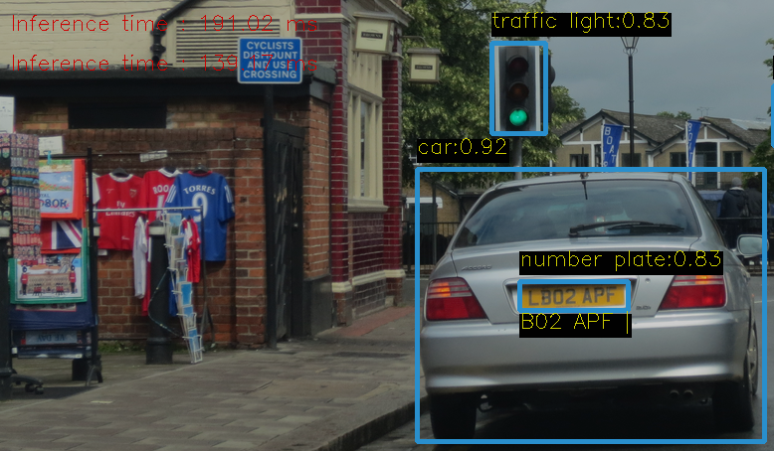
Object Detection Results

Slide 6
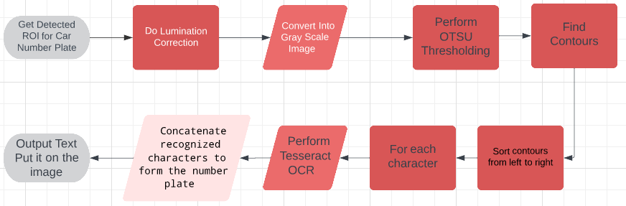
Number plate recognition using Tesseract OCR

Slide 7
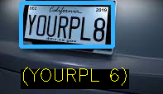
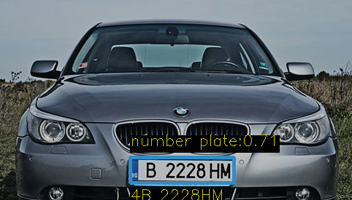
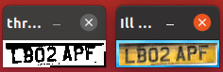
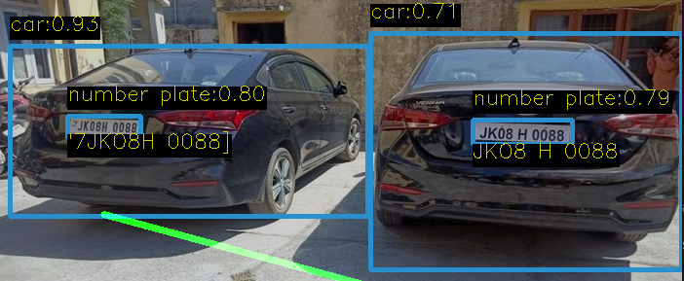
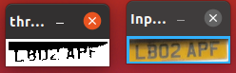
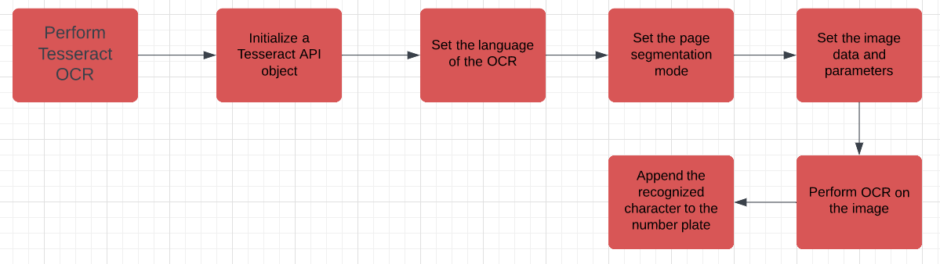
Lumination Correction
Results:
Before Lumination Correction
How to Perform Tesseract OCR

Slide 8
Conclusion
Our system successfully detects lanes and car number plates using a combination of computer vision and deep learning techniques.
It has demonstrated reliable performance in real-time and can adapt to different road conditions.
The potential applications of this system extend beyond the scope of this study and can be used in various fields such as road safety, traffic management, and security.
In summary, our system offers a promising solution for detecting lanes and car number plates autonomously, which could significantly improve road safety and security.

Slide 9
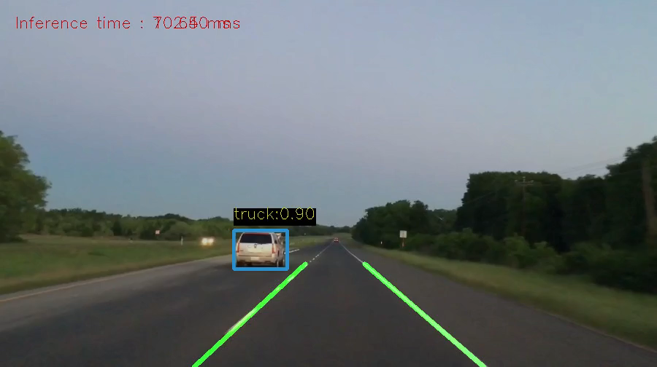
Results

